Slide 1


B.N.M. Institute of Technology
An Autonomous college under VTU, Approved by AICTE, Accredited as grade A Institution by NAAC till 31.12.2026.
All Eligible UG branches – CSE, ECE, EEE, ISE & ME, accredited by NBA till 30.06.2025
Post box no. 7087, 27th cross, 12th Main, Banashankari II Stage, Bengaluru- 560070, INDIA
Ph: 91-80-26711780/81/82 Email: principal@bnmit.in, bnmitprincipal@gmail.com, www.bnmit.org
Mini-Project (18ECMP68)
EMF Detector Using Arduino
 | ABDUL MANNAN S 1BG20EC013
Under the guidance of
Mrs. Anuradha J P
Assistant Professor
Dept. of ECE, BNMIT

Slide 2
Contents
INTRODUCTION
PROBLEM STATEMENT
MOTIVATION
OBJECTIVE AND SCOPE
LITERATURE SURVEY
DESCRIPTION OF MINI-PROJECT WORK
Software requirements
Hardware requirements (if any)
IMPLENTATION
RESULTS
CONCLUSION
REFERENCES

Slide 3
Introduction
An electromagnetic field (EMF) detector is a device that measures the strength and presence of electromagnetic radiation in its surroundings. It is often used to detect and measure the levels of electromagnetic fields emitted by various electronic devices, power lines, or other sources.
In this guide, we will explore how to build an EMF detector using an Arduino microcontroller. Arduino is an open-source electronics platform that provides a simple and cost-effective way to create interactive projects. By combining Arduino with a few additional components, we can construct a basic EMF detector that can detect and display the intensity of electromagnetic fields.

Slide 4
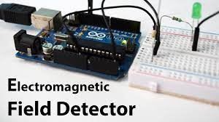

Slide 5
Problem statement
Designing an EMF (Electromagnetic Field) detector using Arduino to measure and detect the presence of electromagnetic fields in the surrounding environment. The detector should provide reliable measurements and display the results in a user-friendly format, allowing individuals to make informed decisions about their exposure to electromagnetic fields and take necessary precautions.

Slide 6
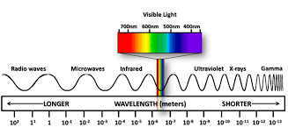

Slide 7
Motivation
There can be several motivations behind creating an EMF (Electromagnetic Field) detector using Arduino:
Curiosity and Learning: Arduino is a popular platform for DIY electronics projects, and building an EMF detector can be a fascinating way to explore the world of electromagnetic fields, electronics, and sensors. It allows you to gain a deeper understanding of how electromagnetic fields work and how they can be measured.
Personal Safety: EMF detectors are commonly used to measure the intensity of electromagnetic fields in the environment. Some people are concerned about potential health risks associated with prolonged exposure to high levels of electromagnetic radiation. By building your own EMF detector, you can monitor the electromagnetic field levels around you and make informed decisions regarding your exposure.

Slide 8
Objective and Scope
OBJECTIVES:
• To Design a EMF detector which would be sensitive enough to detect low levels of electromagnetic radiation.
• The EMF detector should provide accurate and precise measurements of the electromagnetic fields it detects, with minimal error or variability.
• The EMF detector should be able to detect and measure electromagnetic fields across a wide range of frequencies, from radio waves to microwaves and beyond.
SCOPE:
• It involves the design and prototyping of the device, including the selection of components, circuit design, and testing.
• To evaluate the device based on its performance, including sensitivity, range, accuracy, and precision.
• The device may need to comply with safety and regulatory requirements.

Slide 9
Literature Survey
[3] Z.H. Bohari, M. F. Sulaima, M. N. M. Nasir, W. M. Bukhari, M. H. Jali, M. F. Baharom, in their paper, “A Novel Electromagnetic Field Detector for Extremely Low Frequency Energy” , presents a EMF detector made with an Arduino Nano can help measure and detect electromagnetic fields around you. It uses various components like the Arduino Nano itself, an EMF sensor module, an LCD module (for displaying information), and a buzzer (for making sounds). The Arduino Nano acts as the brain, processing the signals from the EMF sensor and controlling the output to the LCD and buzzer. The EMF sensor detects electromagnetic fields and sends signals to the Arduino, which then displays the readings on the LCD and sounds the buzzer if the field exceeds a certain level.

Slide 10
[4] Mirko Pavleski in his project “EMF Detector Using Arduino” , Presents a device that can detect weak electromagnetic fields. It shows the field strength on an LCD display and gives a signal through a buzzer and LED light. The sensor used is a copper wire, but other types of wire or metal can be used. Sensitivity can be adjusted through the code or by changing the resistor connected to A0 and grounding. A switch allows for selecting different resistor values to adjust sensitivity. Calibration can be done by comparing it to a calibrated industrial device.
[5] T.K. HAREENDRAN in his project “Simple EMF Detector/Meter”, Recently built a simple electromagnetic field (EMF) detector based on a code by Christian Figge that I found on the web. My design includes a 10-LED bar graph (from eBay), which I used to display measurement results. My prototype works well and detects the electromagnetic field generated by electrical appliances, computers, radios, and more from a short distance.

Slide 11
Description of Mini-Project
SOFTWARE REQUIREMENTS
The Arduino IDE (Integrated Development Environment) is a software application used for writing, compiling, and uploading code to Arduino boards. It provides an easy-to-use interface for beginners and advanced users to program their Arduino microcontrollers.
To use the Arduino IDE, you can follow these steps:
Connect Arduino Board: Connect your Arduino board to your computer using a USB cable. Make sure your board is properly recognized by your computer (drivers might need to be installed).
Launch Arduino IDE: Open the Arduino IDE that you installed in the first step.
Select Board and Port: From the "Tools" menu, select the appropriate Arduino board you are using (e.g., Arduino Uno, Arduino Mega). Also, choose the correct port to which your Arduino board is connected.

Slide 12
Description of Mini-Project
Write Code: In the Arduino IDE, you will see a text editor where you can write your Arduino code. You can start with the basic "Blink" example, which is often used to test the connection. Write or paste your code into the editor.
Verify and Compile: Click on the "Verify" button (checkmark icon) to compile your code. The IDE will check for any syntax errors in your code. If there are errors, you will need to fix them before proceeding.
Upload to Arduino: Once your code is successfully compiled, click on the "Upload" button (right arrow icon) to upload the code to your Arduino board. The IDE will compile the code again, and if everything goes well, it will upload the compiled binary to the Arduino.
Monitor Serial Output: You can monitor the output of your Arduino board by opening the Serial Monitor. From the "Tools" menu, select "Serial Monitor." You can use the Serial Monitor to send and receive data between your Arduino and the computer.

Slide 13
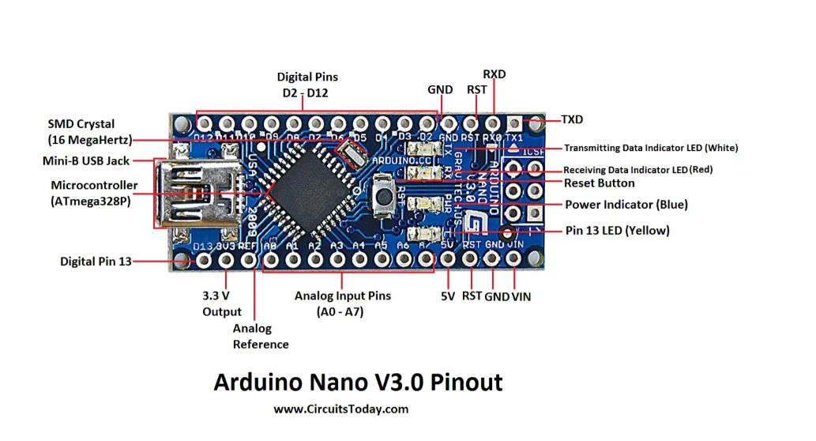
HARDWARE REQUIREMENTS
ARDUINO NANO:
To create an EMF (Electromagnetic Field) detector using an Arduino Nano, you will need a few additional hardware components.
Arduino Nano: This microcontroller board will serve as the brain of the EMF detector.

Slide 14
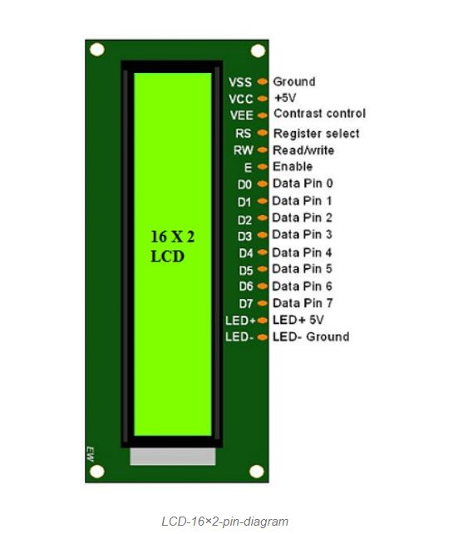
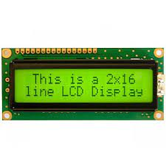
LCD(Liquid crystal display):
The LCD (Liquid Crystal Display) module used in the EMF detector is typically a character-based LCD that can display alphanumeric characters. The most common types used are 16x2 and 20x4 LCD modules, which refer to the number of characters each line can display.

Slide 15
Antenna:
When building an EMF detector, a copper wire antenna is often used to capture and detect electromagnetic fields
Antenna Purpose: The antenna serves as a receiving element in the EMF detector
Copper Wire Selection: Copper wire is commonly used for antennas due to its excellent electrical conductivity.
Length of the Antenna: The length of the copper wire antenna is an important factor in determining its reception capabilities.
Antenna Orientation: The orientation of the copper wire antenna can influence its sensitivity to different types of electromagnetic fields.
CONNECTING CABLE:
To connect the components of a EMF detector you will need the following cables:
Jumper wires (male-to-male, female-to-male, and female-to-female)Power cables (e.g. USB cable for powering the microcontroller)

Slide 16
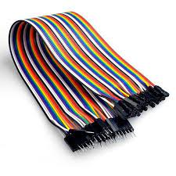
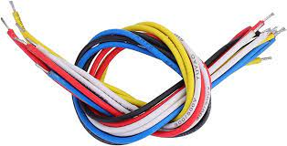

Slide 17
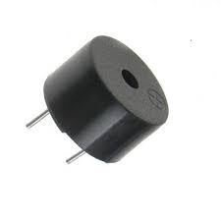
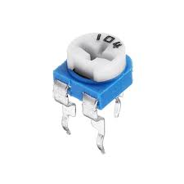
Buzzer:
In an EMF detector, a buzzer is typically used to provide an audible indication when the detected electromagnetic field exceeds a certain threshold. The buzzer emits a sound or tone to alert the user when there is a significant presence of electromagnetic radiation.
100k Variable Resistor:
A 100k variable resistor, also known as a potentiometer, is a type of electrical component that allows you to adjust the resistance along its track. It consists of three terminals: two outer terminals and one middle terminal.

Slide 18
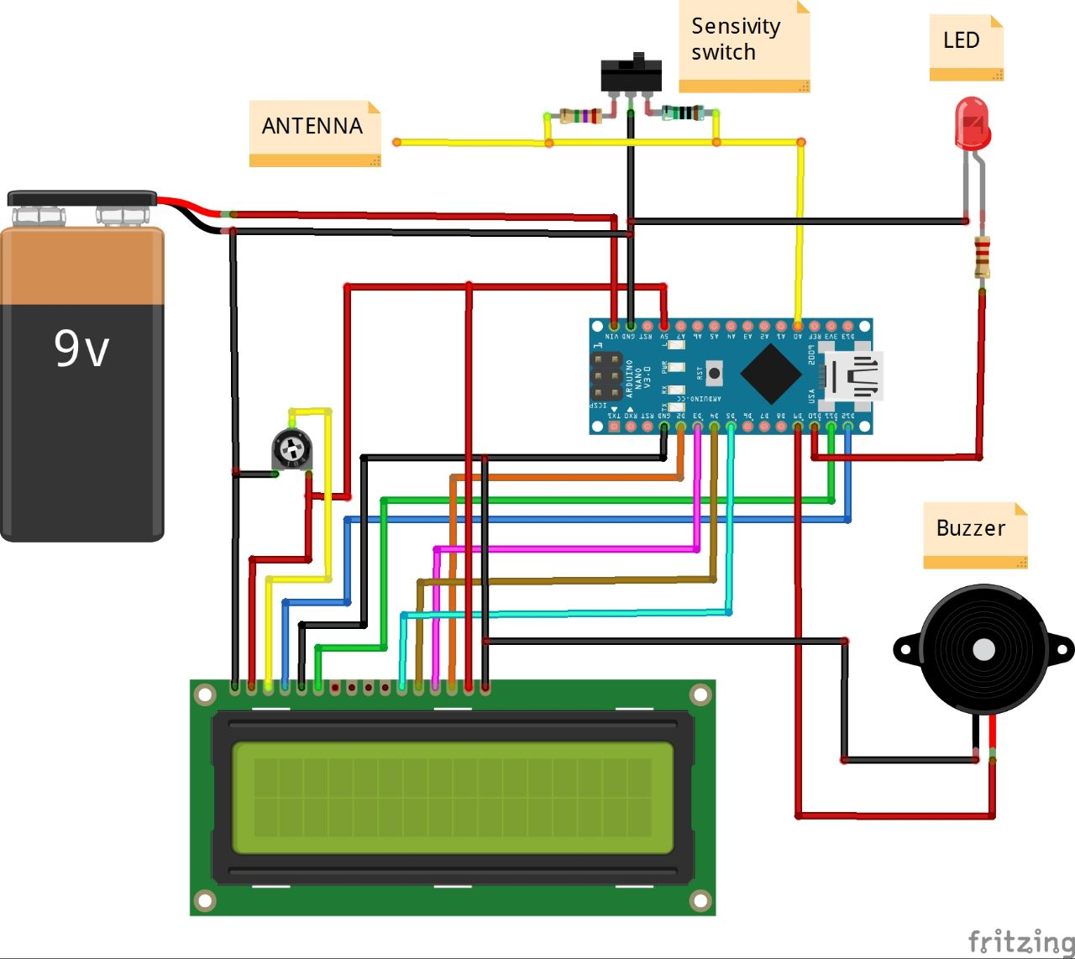
Implementation

Slide 19
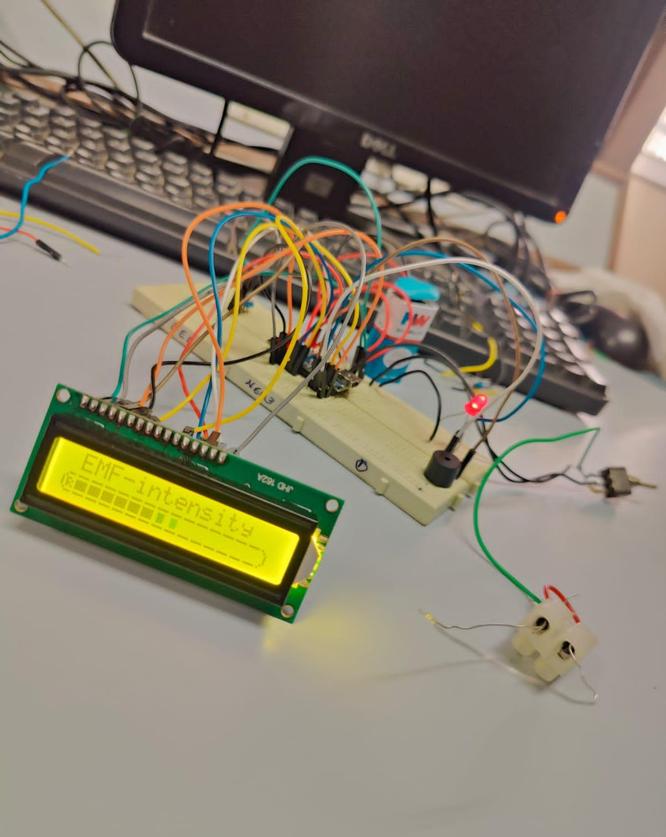
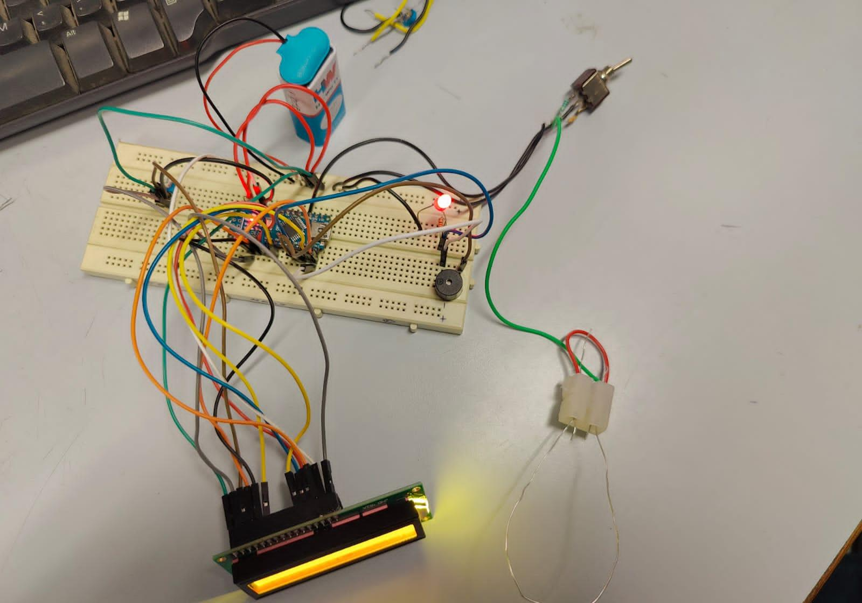

Slide 20
Results
The result of an EMF detector using an Arduino Nano gives the EMF detector will provide a measurement or indication of the strength of the electromagnetic field being detected.
Sound Output: In addition to a visual display, you can incorporate a buzzer or speaker into the EMF detector circuit. The Arduino Nano can be programmed to activate the buzzer or produce different tones based on the strength of the electromagnetic field. For example, the buzzer may emit a continuous tone or beep faster as the field strength increases.
EMF Intensity: using Arduino Nano and LCD display we are able to detect the intensity of the EMF in the surrounding environment and display the range of EMF field i.e., the EMF intensity is displayed on the LCD display. The EMF intensity varies according to EMF field and the corresponding EMF intensity is displayed on the LCD.

Slide 21
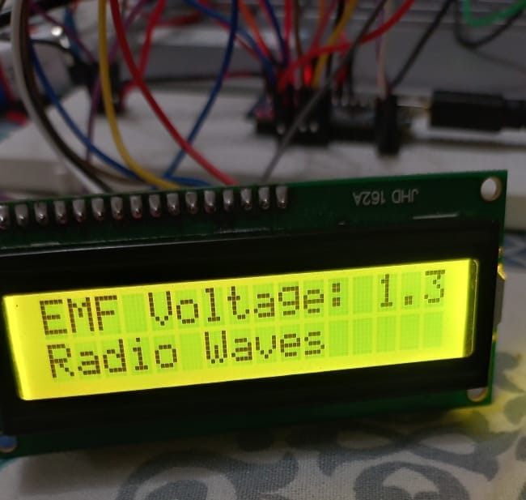

Slide 22
Conclusion
An EMF detector built using an Arduino Nano can be a useful tool for measuring and detecting electromagnetic fields in its vicinity. By combining an Arduino Nano with an EMF sensor module, LCD module, and potentially a buzzer, you can create a device that provides real-time readings of EMF levels and alerts the user when certain thresholds are exceeded.
The Arduino Nano serves as the brain of the EMF detector, processing the input from the EMF sensor module and controlling the output to the LCD module and buzzer. The EMF sensor module detects electromagnetic fields and converts them into electrical signals that can be read by the Arduino. The LCD module allows for the display of EMF readings, providing a visual representation of the detected electromagnetic field intensity. The buzzer, if included, adds an audible alert to notify the user when the EMF levels surpass a predefined threshold.

Slide 23
Future Enhancements
Some potential future enhancements for the device described below:
Increased Sensitivity: Future enhancements could focus on improving the sensitivity of the EMF detector. This could involve using more advanced sensors or signal processing techniques to detect even smaller electromagnetic fields.
Multi-Frequency Detection: An enhanced EMF detector could be designed to detect and analyze electromagnetic fields at multiple frequencies. This would allow for a more comprehensive understanding of the surrounding electromagnetic environment.
Data Logging and Analysis: The Arduino-based EMF detector could be equipped with data logging capabilities to record and store measurements over time. This would enable users to analyse the data later and identify patterns or trends in electromagnetic field levels.
Wireless Connectivity: Future enhancements could include adding wireless connectivity options to the EMF detector. This would allow users to remotely monitor and control the device, as well as transmit data to a computer or mobile device for further analysis.

Slide 24
References
[1].Author(s): Adarsh Kumar, Yashwanth Sandupatla and Vishesh Arya from IIT Bombay “EMF Detector” Project Report.
[2].“Arduino EMF detector”, Instructables, [Online]. Available: https://www.instructables.com/Arduino-EMFDetector/
[3]. Author(s): Z. H. Bohari, M. F. Sulaima, M. N. M. Nasir, W. M. Bukhari, M. H. Jali, M. F. Baharom 1, 2, 3, 4, 5, 6, Department of Diploma Studies, Faculty of Electrical Engineering, UTeM “A Novel Electromagnetic Field Detector for Extremely Low Frequency Energy”
[4].Hackster.io :https://www.hackster.io/mircemk/diy-ultra-sensitive-emf-detector-4be895#schematics
[5]. Simple EMF Detector/Meter by T.K. HAREENDRAN: https://www.electroschematics.com/simple-emf-detectormeter/

Slide 25
Thank You

